Slide 1
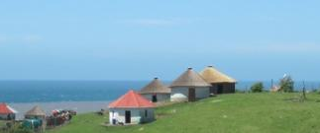



Changing land use patterns in communal areas of South Africa:
Drivers, consequences and policy implications
Sheona Shackleton
African Climate & Development Initiative
University of Cape Town
Notes:
Good day colleagues. My name is Sheona Shackleton and I work at the African Climate and Development Initiative at the University of Cape Town. I will be talking about the changing land use patterns we are seeing in South Africa, the drivers of these changes, and their consequences and implications.

Slide 2
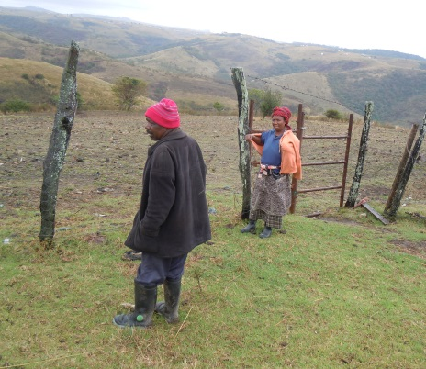

About this talk
Over half a million households in South Africa’s former homelands disengaged from farming between 2011 and 2016, according to Statistics South Africa. This represents a loss of one in five crop farming households.
Notes:
I will start by taking us through the purpose and structure of this talk. The quote from Statistics South Africa that says: Over half a million households in South Africa’s former homelands disengaged from farming between 2011 and 2016, which represents a loss of one in five crop farming households provides some context for what I will be considering. However, I will focus much more on the local scale and provide additional evidence and insights into this concerning trend.

Slide 3
Purpose and focus of this presentation
AIM: To synthesise findings from several studies from South Africa to understand the observed shift away from field cultivation and other land use changes in communal areas of the country.
WHY?
Inadequate consideration of:
  the rates and scales of field deactivation and land use change more widely across South Africa and region (most work has been done in the Eastern Cape)
  the livelihood, food security and ecological consequences of such changes
  the use of interdisciplinary research, multiple methodologies and data sources to build a comprehensive picture of the complex changes taking place
  what these changes mean for rural development and agrarian policy in a time of increased vulnerability and global change
Notes:
The aim of this talk is to synthesise findings from several studies from South Africa to understand the observed shift away from field cultivation and other land use changes in communal areas of the country. We don’t know enough about the rates and scales of the changes across the country and region, how we might better understand these changes through interdisciplinary approaches, what these changes mean for people and their lives, and for policy and practice going forward in a time of global change and uncertainty.

Slide 4
Purpose and focus of this presentation
WHAT?
In this talk I will:
  provide evidence of changes and trends in land use patterns from various different communal areas in South Africa
  consider how this translates to changes in livelihood portfolios
  explore some of the consequences for livelihoods and ecosystem services
  draw out the main messages and consider the policy implications, especially in relation to the crises of climate change and COVID-19 pandemic
Notes:
Regarding the structure of the talk, my focus will be providing evidence of the trends, drivers and consequences from multiple studies from across South Africa. From this I will draw out the key messages and policy implications. Where relevant, I may bring in reference to some of what is happening in terms of COVID-19 lockdown policy to highlight the vulnerability of these rural livelihood systems.

Slide 5
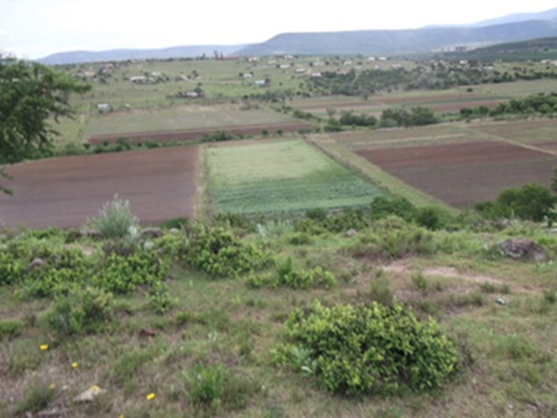
Framing
Landscape and livelihoods are interconnected and interdependent in multiple ways
Notes:
In the next slide I would just like to briefly introduce a framework that I have been using in my work to understand landscapes and livelihood change. I feel it is important to look at what is happening in terms of field cultivation from a dynamic systems perspective.

Slide 6

Thinking systemically about livelihood and landscape change, outcomes and trajectories
History, path dependency and stagnation
Context and social differentiation
Trajectories
We need a systemic and dynamic view of local livelihoods and their relationship to the landscapes and ecosystems services they draw on.
Dorward et al.’s (2009) framework
Stepping up/out
+ve drivers
Hanging in
Global - Local
Altered Livelihoods and Landscapes\ social-ecological systems
Shocks
Stressors
Stuck/Trap?
Losing out/spiraling down
-ve drivers
No single pathway
Transformation
New favourable trajectories
Past to future
Notes:
This systemic and dynamic view of local livelihoods and the landscapes and ES they depend on starts by recognising multiple drivers of change over both temporal and spatial scales – these drivers cause changes in interlinked landscapes and livelihoods. The outcomes of these changes are influenced by history, the local social, ecological and economic context as well as social differentiation (i.e. who you are and assets you have). These outcomes in turn influence the trajectories livelihoods are taking. In terms of transformation we need to know what is needed to take more livelihoods onto more sustainable trajectories recognising that there is no single pathways for this. I will come back to some of these issues as I move through my talk.

Slide 7
(From Shackleton et al. 2019, Land Policy)
Notes:
This is a framework used by Charlie Shackleton in his synthesis paper that show the systemic relationships between drivers of change, field deactivation specifically and the outcomes or consequences across multiple parts of the system and scales. Understanding how these interact is important.
I will now move on to actually looking at some of the evidence of the changes taking place starting with a focus on the landscape changes, i.e. the evidence of reduced cultivation.

Slide 8
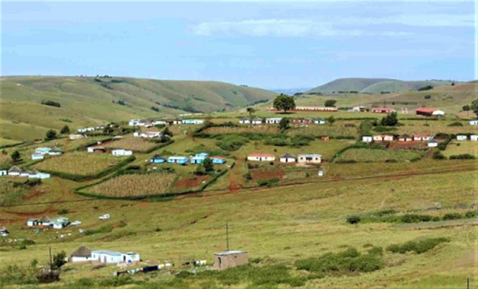
What are the changes in land use patterns?
Data from spatial surveys and methods and household interviews
Notes:
So what are the changes we are seeing? Lets look at some of the evidence.

Slide 9
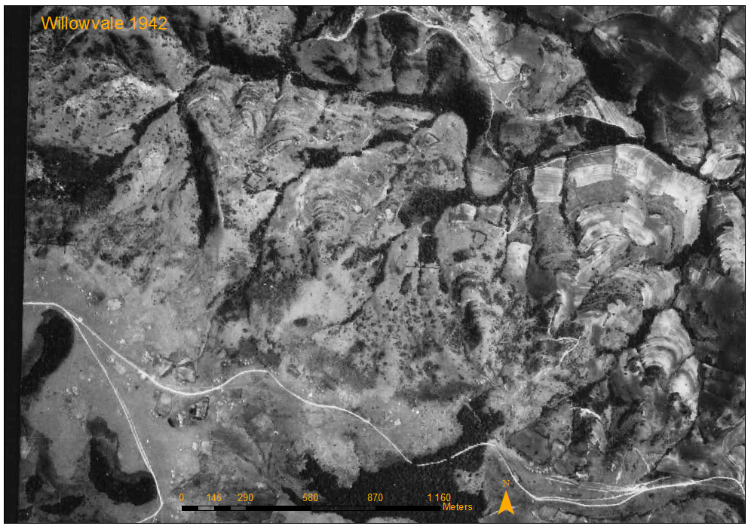
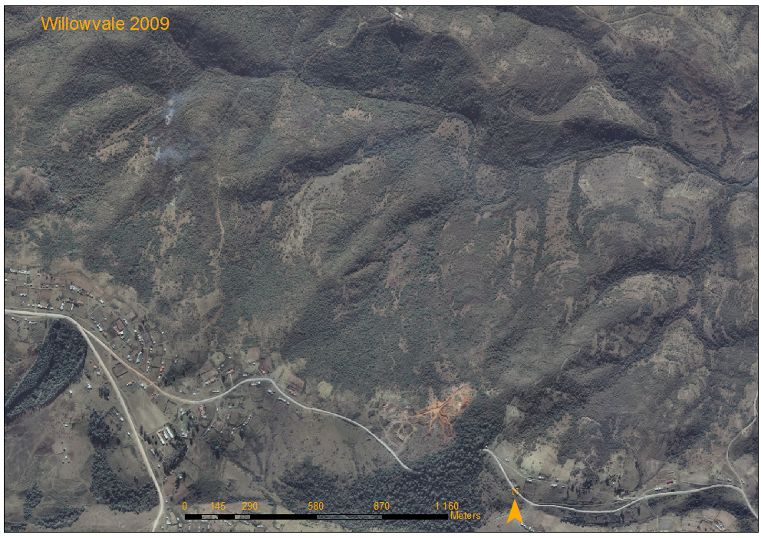
Changes in land use patterns in Gatyana, Wild Coast, Eastern Cape
Arial photos showing vegetation cover change from 1942 and 2009
Shackleton, R., Shackleton, C., Shackleton, S. and Gambiza, J. (2013). Deagrarianisation and forest succession in abandoned fields in a biodiversity hotspot on the Wild Coast, South Africa. PLoS ONE 8(10)
Notes:
In this figure the decline in cultivation of evident in the decline of field, the rise of old fields and increasing woody cover. In this area there is also a decline in gardens.

Slide 10
Landscape changes 1942 – 2009 - Willowvale/Gayana
Increase in wood vegetation is AFRICA wide: https://www.nature.com/articles/s41467-018-04616-8, and Conversation Aug 2018
Decline in farming > increasing woody density/ invasive plants > loss of grazing for livestock > wild animal pests (bush pigs, monkeys) > difficulties opening up fields again > other concerns
“We can no longer walk through the fields because there’s too many trees and it’s
dangerous.”
(From Blair et al., 2019; LAND)
Notes:
This is just the same area but going back to 1942. Same patterns can be seen.

Slide 11
Fairbairn, Kat River Valley, former Ciskei, Eastern Cape
(From, Falayai 2017, unpublished thesis)
Notes:
This is a different part of the Eastern Cape , but shows very similar patterns. Here the biggest step changes occurred between 1967 and 1996.

Slide 12
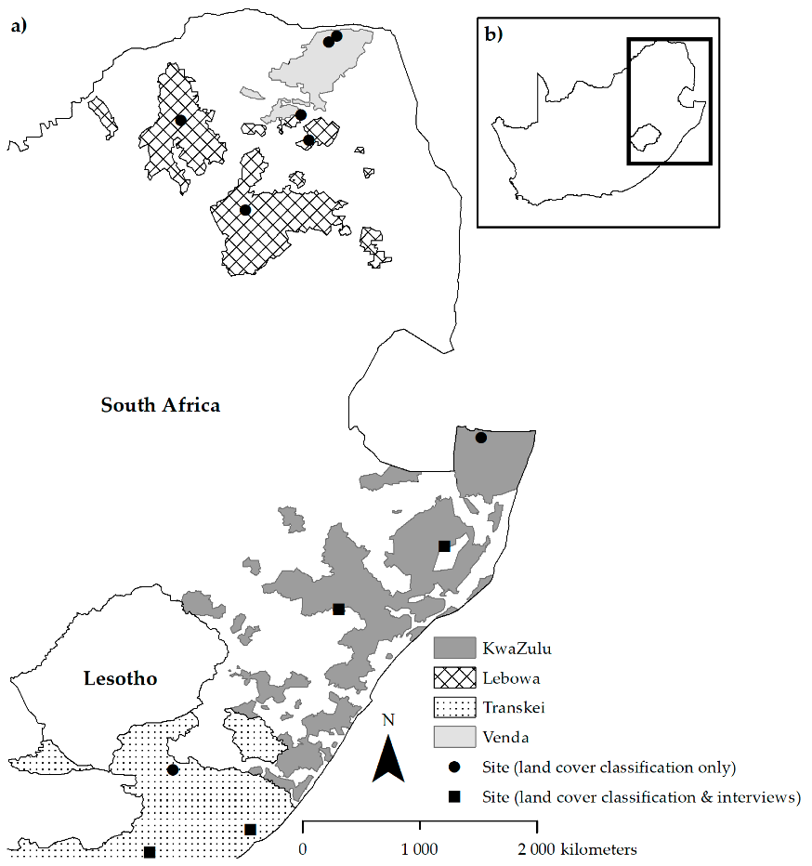
Change in land surface area under active cultivation and deactivated fields from the 1950s to 2010s in four former homelands with 3 randomly selected villages per ex homeland (note: y-axis scales differ)
(a) Transkei (n=3)
(b) KwaZulu (n=3)
(c) Lebowa (n=3)
(d) Venda (n=3)
(From: Blair et al. 2018; LAND)
Notes:
This study looks at landuse changes more widely beyond the Eastern Cape to other communal areas (previous bantustans) in South Africa. Again, a similar trend is visible, with the land area under uncultivated fields overtaking that under cultivation in some regions.

Slide 13
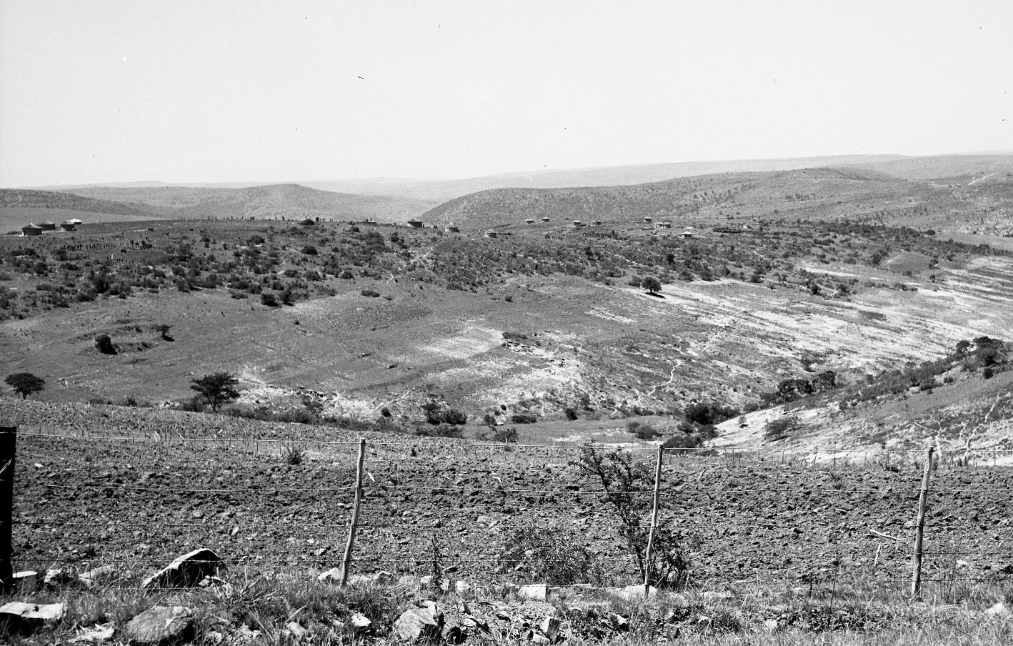
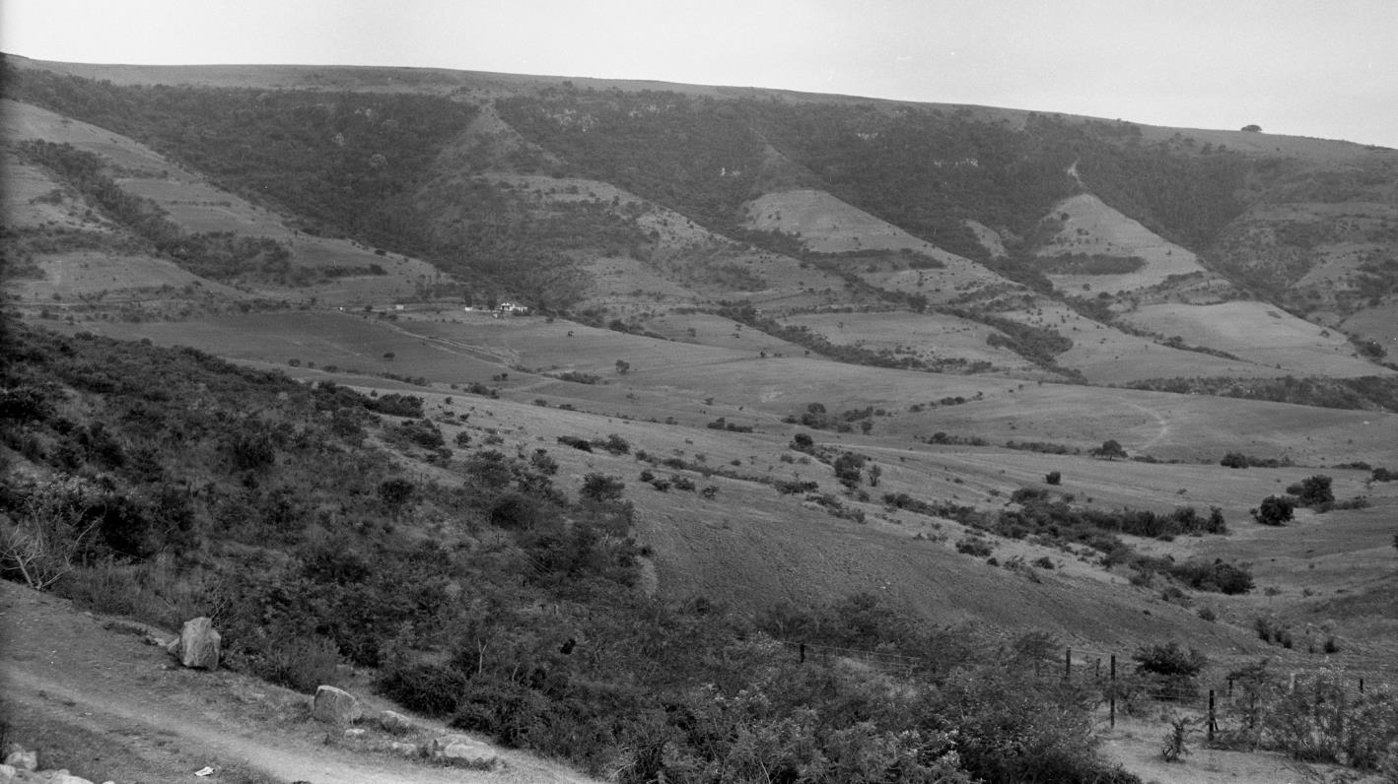
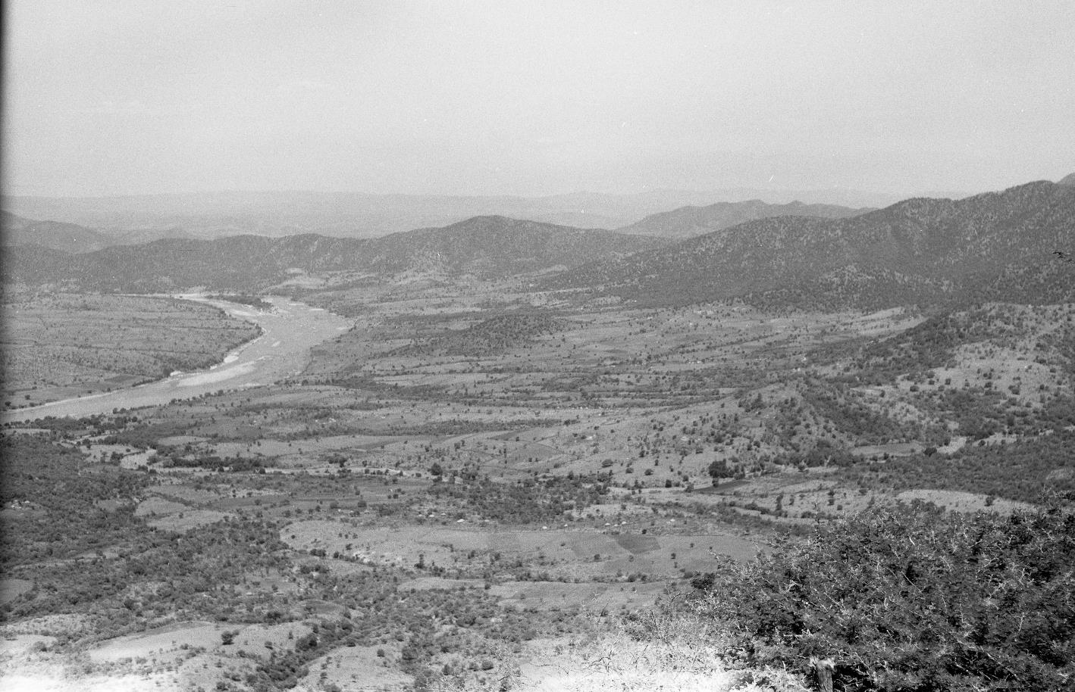
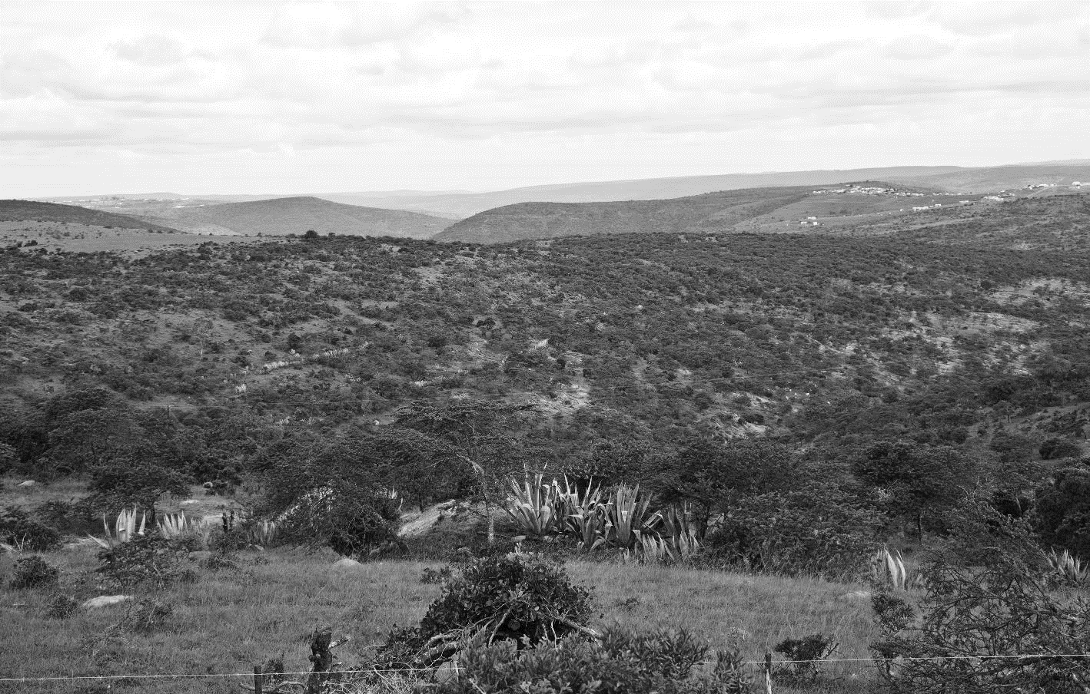
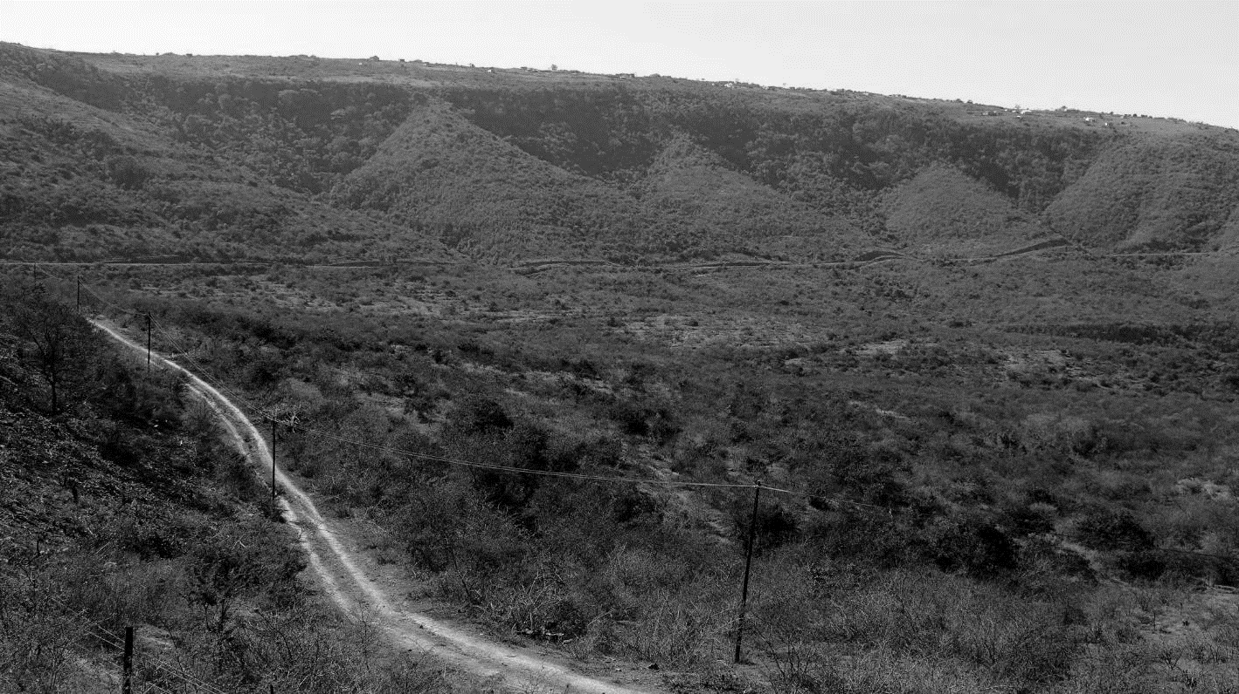
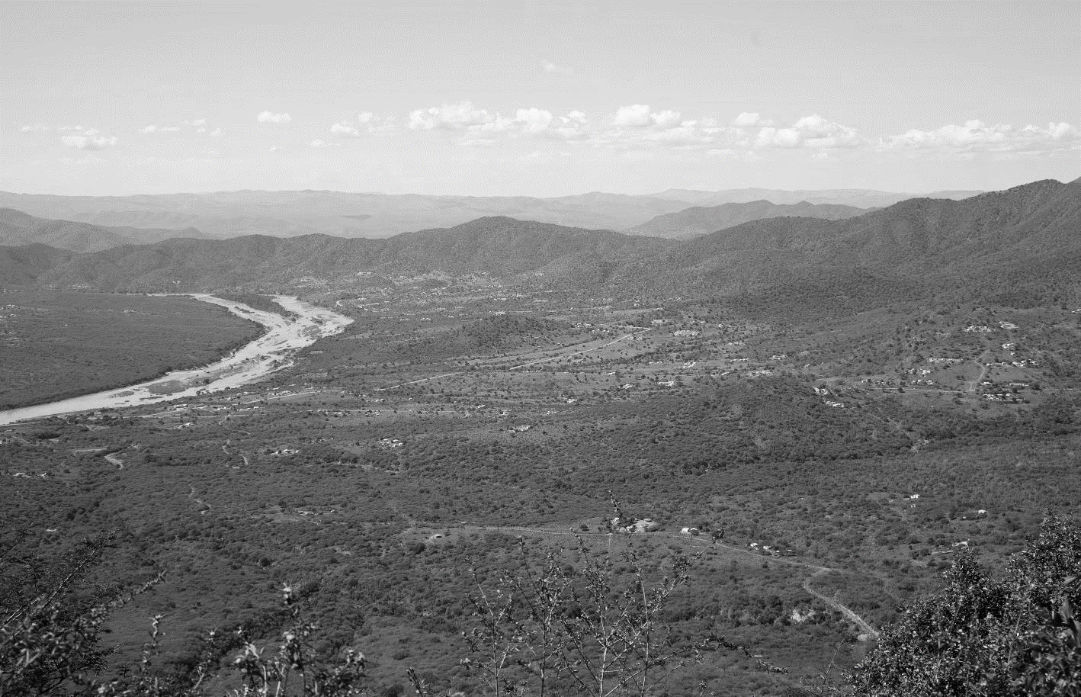
Paired fixed-point photos showing decline in cover of fields and increase in cover of woody vegetation (photos supplied by Timm Hoffman)
Ciskei 1956 and 2011
Transkei 1954 and 2010
KwaZulu 1957 and 2010
(From: Shackleton et al. 2018; Land Use Policy)
Notes:
Different sources of data show similar findings – here we have fixed point photographs. The decreases in cultivated fields is significant and the increasing woody density is clearly visible.

Slide 14
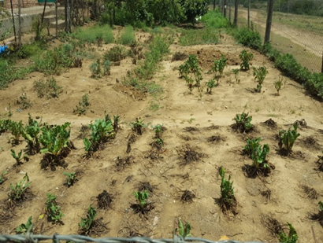
Cultivation in Fairbairn and Ntloko in former Ciskei, Eastern Cape
Percentage of households with current access to a field/s and percentage who currently cultivate a field/s.
 | Households with current access to fields (n= 60) (%) | Households that currently cultivate their fields (n= 60) (%)
Fairbairn | 25 | 13
Ntloko | 50 | 8
(From Brooks, 2017; unpublished thesis)
Notes:
Looking at survey data we see the same trend although it varies with context. In Fairbairn about half of hh with fields are still cultivating, whereas in Ntloko only 16% are still cultivating. There are data like this from other parts of the country.

Slide 15
Who is cultivating?
Not all youth disinterested and many helping parents
Percentage of households cultivating field/garden according to income category
 | Fairbairn | Ntloko
 | % of households cultivating
High Income (n= 20) | 60 | 70
Middle Income (n= 20) | 70 | 50
Lower Income (n= 20) | 40 | 50
(From Brooks, 2017; unpublished thesis)
Notes:
It is interesting to look at who is involved in cultivation – in the graph we can see this according to hh members and again varies across sites – but men and women are cultivating with more men in Fairbairn (due to more commercialisation). Young people in the family do still assist and other work we have done show this, e.g. my work with Paul Hebinck re who is still farming fields on the wild coast. Most of those who were still farming their fields included the whole family and the youth we spoke to were still keen. From the table it can be seem that is generally that are cultivating rather than the lower income because of the costs involved.

Slide 16
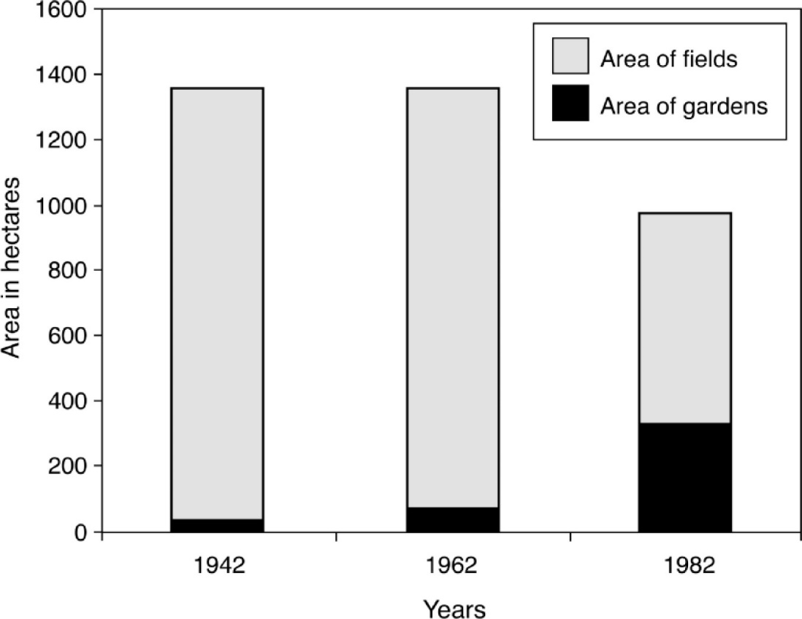
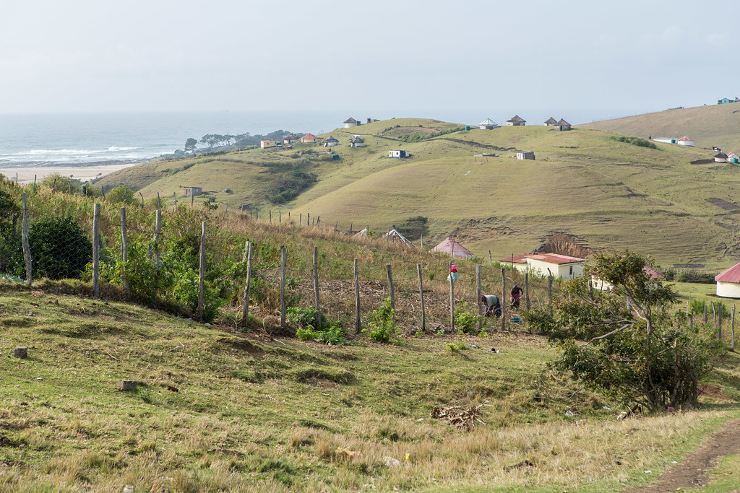
Decreasing fields but intensification of home gardening
(From: Andrew & Fox 2004; Development Sth Africa)
https://hiveminer.com/Tags/africa%2Cxhosa/Timeline
(From: Mtati 2014)
Notes:
Just other data and sites to show the increase in home gardens. This type of cultivation is very important for food security but is little recognised in policy. Home gardens vary in size and may be just a vegetable garden or on parts of the Wild Coast a large plot of up to 1 ha where maize is also grown.

Slide 17
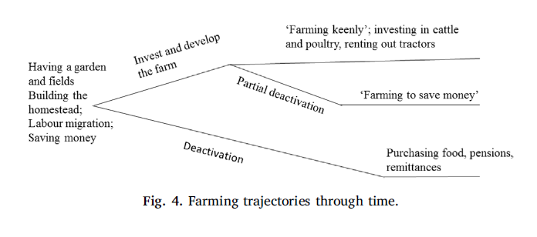
Exceptions to trends - field farming is still alive
Small proportion of households still farming fields, and people come and go from this activity
2 ‘styles’ of field farming
  farming keenly
  farming to save cash
Several parallel pathways/trajectories
  into future
More than a ‘single story’
“…most people are not passionate about farming, of all the fields available locally only 3 are planted”. (elderly man)
“Farming is my life. I live farming.” (middle aged woman)
“It saves me money to continue farming….”. (middle aged man)
Notes:
Like the previous slide, this slide shows that deagrainisation can be too definitive a term – it was the results of this study that made us use the term deactivation. So we need to be careful about generalising – there are still some keen farmers and there is more than a single story around the dynamics of field cropping in the Eastern Cape.

Slide 18
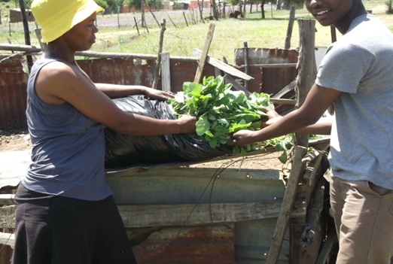
What are the drivers of these changes?
Multiple interlinked changes and factors responsible – not a simple story
.
Notes:
So I think the previous slides indicate that there is real evidence regarding a decline in cropping in rural South Africa, but what is driving this. Again it is very complex – if you think back to the framing I provided – drivers interact with one another across scales and the contexts that they affect resulting in different outcomes.

Slide 19
What was driving the changes observed? Gatyana, Wild Coast, Eastern Cape
Social-economic | Urbanisation and permanent out-migration, loss of jobs especially in mining, HIV/aids
Place-based | Decline in livestock, skewed population and labour concerns, more raiding wildlife (increasing forest), decline in extension services, weather unpredictability/climate change
Changing perspectives and values | New values and ambitions, modernisation, changing family dynamics and fragmentation
Erosion of social capital | Cultural collective practices (e.g. assoc with farming) declining, loss of NRM institutions
Crime and other maladaptive behaviour | Theft of cattle/crops, corruption
What about stagnation and path dependency?
This situation has been amplified during COVID -19
(From; Shackleton and Luckert, 2015)
 | Betterment (sep of people and fields), separate development and continued neglect, no secure land rights and tenure, migrancy, poor service delivery, poor levels of education (continuing)
Legacy of apartheid
Notes:
There are many different ways the drivers can be classified, but in this slide I focus mainly on local drivers. The important point is that no one driver is responsible for the trends we are seeing. Some of the socio-economic drivers include migration away from rural areas, changes in traditional migrant systems and job loss, HIV/aids and economic impacts from this. Very local level changes include less livestock for ploughing, less labour availability, less extension support, and environmental drivers like CC and increasing wildlife. Other changes include altered perceptions and ambitions of what is work, changing family dynamics; loss of collective support. Then this whole situation is affected by the past and continued neglect of rural areas which has a strong influence on what is possible. These are only some of the drivers, there are many others. But the connection between them can be seen and this is what makes it so much more difficult to address and reverse the trend.

Slide 20
Drivers and vulnerabilities - some of these are on-going in rural livelihood, some are ‘new’ and some are exacerbated by changes in for example climate and policy.
Local National Global
Lack of policy support to small-scale producers – especially long-term
Urban bias in policy making
Changes in local social-ecological dynamics
Shortfalls in institutional capacities
Climate changes
  Limited and unequal levels of extension services and support
  Low levels of assets and safety nets for recovery
Extreme events
  Conflict and economic shocks
  Poor governance and pervasive inequality
  Poor health and nutrition (HIV/AIDS)
  Insecure tenure
  Unreliable markets
  Land degradation
  Inappropriate policies to some contexts such as commercialisation/intensification/ monocrops which could drive inequality, or promotion of non-food crops which could affect food diversity and security
  Youth unemployment and social conflict
Notes:
This is a more global picture of drivers and vulnerabilities in rural livelihoods. I will not go through all of these bubbles but just want to highlight a few of the higher level policy issues in blue – these include urban bias, poor institutional capacity and governance, insecure tenure, and inappropriate policies which has been part of the problem in South Africa – where the focus has been on commercial production, often of non-food crops, and little recognition of the safety net role of cropping.

Slide 21
(From: Blair et al. 2018; LAND)
Notes:
This slide shows results from a wider survey and focusses on local perceptions of drivers. How people themselves view the drivers may be different to how external policy makers see them - it is the lack of traction power that comes out as a major reason as well as environmental factors, but people also recognition that hh have alternative sources of income and that farming may not be ‘worth’ it.

Slide 22
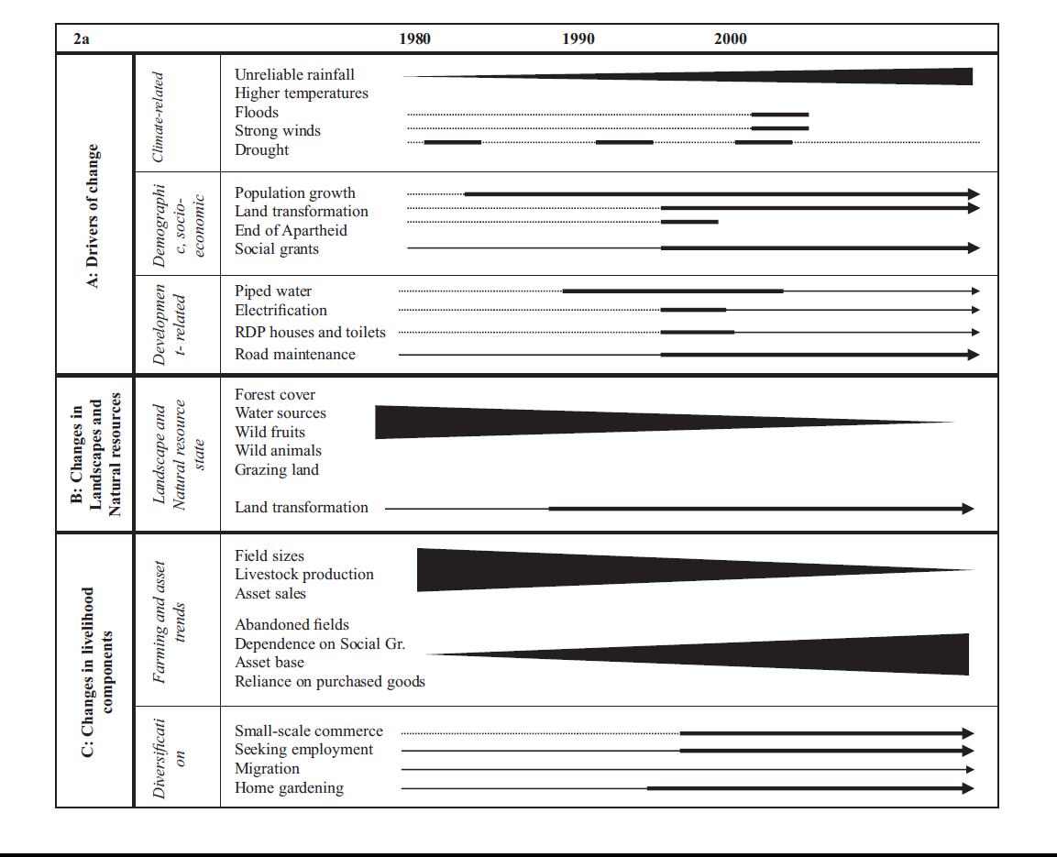
Drivers and livelihood and landscape change in Tshivulani (SA)(also done for Marwendo, Zimbabwe) over 30 years (human-environmental timelines)
SA
From: Masunungure, C & Shackleton, S.E. (2018) Land., Exploring Long-Term Livelihood and Landscape Change in Two Semi-Arid Sites in Southern Africa: Drivers and Consequences for
  Social–Ecological Vulnerability
Hanging in
Notes:
Again, just to show similar findings from another part of the country in this human-environment timeline constructed from various sources of data. This shows both +ve and –ve drivers of livelihood change, not just field deactivation. I will not go through it but similar issues emerge.

Slide 23
Climate shocks also important
CC change will not just affect food security through its impacts on local agriculture but also it effects on the global food system and the prices of purchased food.
(From: Clarke 2012)
Notes:
Climate related shocks are seen as a real problem – one of the reasons people are saying that farming is not necessarily worth it.

Slide 24
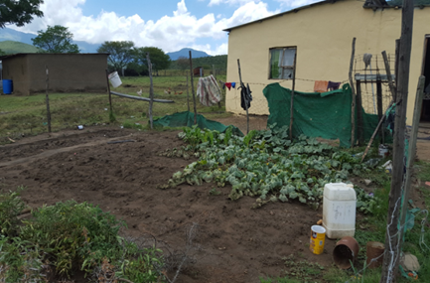
What are the links with livelihoods?
Parallel changes in and consequences for livelihood resilience and food security
Notes:
In the next set of slides we are going to look at some of the parallel changes in livelihoods and the consequences for livelihood resilience.

Slide 25


Drivers have acted over a long time period to alter livelihood portfolios
2 villages: Koloni & Guquka in former Ciskei, Eastern Cape
(From: Hebinck & van Averbeke 2007)
Notes:
So this slide is just to show that the changes in livelihood portfolios have not been sudden but have taken place over a long period of time. We can also see how livelihoods have become more diverse.

Slide 26
Livelihood sources differentiated across different social groups
Lesseyton – peri-urban
Willowvale - rural
Paper, in prep
Notes:
If we look at the rural Eastern Cape, the overwhelming source of income comes from social grants that make up just less than half to over half of cash and in kind income. Land based activities form about 20% of income. This lowest for peri-urban high income hh. What is interesting is that the majority of the in kind income is coming from natural resource harvesting rather than cropping and this is higher in the female only hh (no male adult members). The better off households have more income from livestock that include both in kind and cash income. It is only in Willowvale that these hh have more income from cropping.

Slide 27
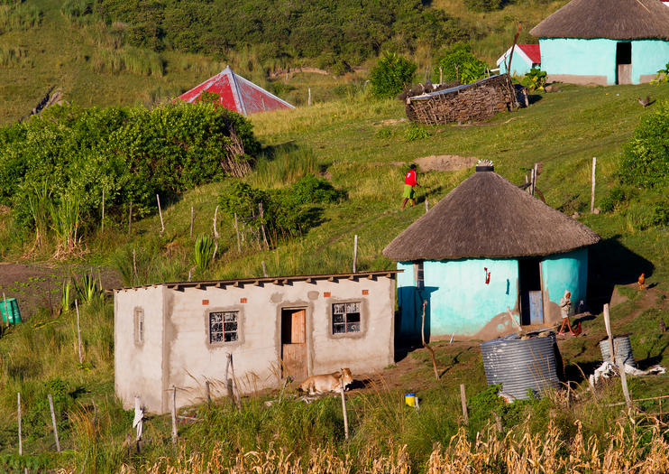
What do livelihood portfolios look like across 1200 households, at six sites each paired across a gradient of differing agro-ecological potential?
(From: Mugido & Shackleton 2019; Forest Policy & Economics)
Notes:
What we see in Eastern Cape is also seen in a large survey of some 1200 hh across the communal areas of the country.

Slide 28
Participatory ranking of income sources at 2 different time periods, in Fairbairn, former Ciskei, Eastern Cape
Ranked order of rural income over time (1990-2015)
Livelihood | 1990 (Apartheid) Ranked source of income | 2015 (Post-Apartheid) Ranked source of income
Government Grants | 5 | 1
Sale of fuel wood | 4 | 2
Home Gardens Produce | 7 | 3
Sale of Livestock | 6 | 4
Remittance from migrant workers | 2 | 5
Fields | Not ranked | 6
Formal employment | 1 | 7
Food Parcels | 3 | -
From: Falayi (2017). Masters thesis;
Falayi et al. (2019). Forests, Trees and Livelihoods
Notes:
This slide is from a participatory focus group discussion and shows how the primary sources of income for the hh has changed over time – grants have become the number 1 source of income, followed by sales of fuelwood as opposed to formal employment and remittance in the past. Home gardens again have become more important.

Slide 29
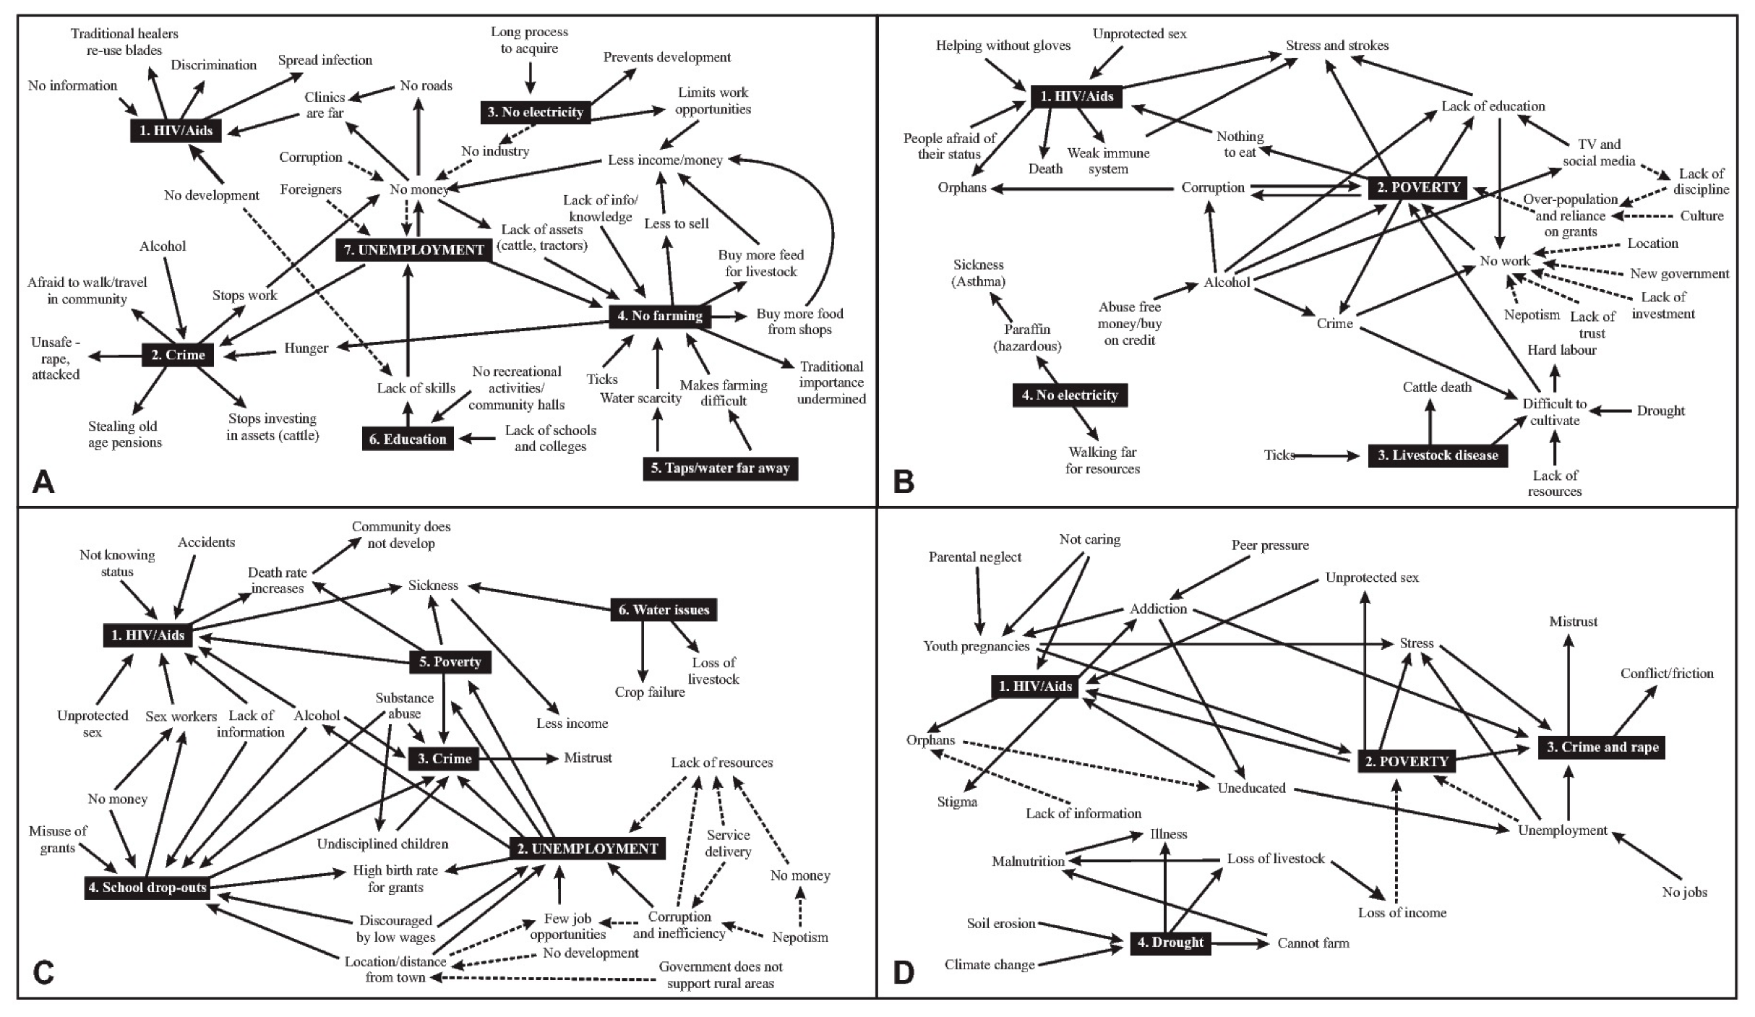

Men
Women
Gatyana
Lesseyton
Notes:
This slide present mental maps of the stressors and vulnerabilities that communities face in the Eastern Cape. It is interesting to see various references to farming – both crops and livestock – and how that is linked to other vulnerabilities in the community. People are concerned about what the loss of agriculture represents and what it means for their lives.

Slide 30
Changes in dependence on purchased food and goods, Gatyana and Lesseyton, Eastern Cape
Narrowing of hh portfolio/less diversified, less use of NR safety nets, more reliance on grants and cash, erosion of fall-back assets, at mercy of markets for food security
LESS RESILIENT?
(From: Clarke 2012, unpublished thesis, Shackleton and Luckert 2015)
Notes:
This slide considers sources of food and what it means for hh. Most hh are relying more on purchased food and most say this makes their lives harder as it requires more cash than just for the food. Amongst, those saying it makes their lives easier, this mainly relates to the risks and costs of farming.

Slide 31
Food sources and food security
(From Brooks, 2017, unpublished thesis)
Household food insecurity access scale HFIAS
Notes:
This slide shows again how most food is being purchased, although some households do combine their own production with purchased food. The bottom table suggest that a minority of hh are food secure. This is a real concern in terms of local resilience.

Slide 32
Increasing woody cover promotes a greater diversity of species used in livelihoods and sale (non-timber forest products)
(From: Njwaxu & Shackleton; in press; Forests)
Notes:
I would like to add another perspective on what the changes mean and in particular the changes in the biodiversity of old fields with time (as in the LH graph). In some cases the increase in useful products for people is providing an alternative source of livelihood and other in kind contributions to the household. Remember the first set of pie charts and the relative importance of natural resource harvesting, especially for female only households. The next slide is a good illustration of this change.

Slide 33
Fairbairn Village, former Ciskei, Eastern Cape: How has sourcing - self-collection vs purchase – changed with time?
ES | % purchasing 2000 | % purchasing 2015
Fuelwood | 6 | 80
Prickly pear | 18 | 68
Traditional imula beer | 15 | 2.5
Sand | 0 | 60
WHY?
more door to door sellers
need for income amongst youth;
introduced sales based on monthly instalments facilitated by small cash payments from new child grants;
increase in pioneer species Vachellia karroo in old fields – increased availability
increasing costs of electricity
Imula beer declined (loss of knowledge, shift in preference to bottled beer)
(from Falayi 2017, unpublished thesis.
Notes:
Fuelwood sales have become an important source of income for young men in the village of Fairbairn (rated number 2 in terms of income). Reasons included increased grant income that supported payment on consignment, more wood, and the need for income earning opportunities amongst the youth and their willingness to do door to door selling. This is despite electricity as shown in the next slide.

Slide 34
Key messages, policy implications and way forward
Notes:
So having presenting a range of evidence for the changes and trends we are seeing in landscapes and livelihoods in the Eastern Cape, I would like to conclude with some of the key messages and policy implications. There are many and it is not easy to cover them all in the time provided.

Slide 35
Take home messages: key findings and implications – local scale
Real marked change in landscapes which has social, economic and environmental implications.
Overall rural livelihoods are becoming less secure and more uncertain – especially when considering future CC.
Food security is a major concern related to the trends we are observing. More dependence on store bought food – less nutritious. Mike Rogan (2018, Dev Sth Africa) has reported that farming households experience less hunger, even though they may be poorer in terms of income. Rural agriculture is an important safety net.
But not everyone wants to be a farmer, or at least a commercial farmer. Livelihoods diverse and people have different ambitions. Farming is one of several sources of livelihood.
Seeing both continuities and discontinuities/new directions in livelihoods – not a linear process. Farming and ES use continue in different forms – home gardening becoming more prevalent.
Different visions of the future for different social groups and the youth vs older generation.
Notes:
I have presented these messages in no particular order, and will go through them one by one.

Slide 36
Take home messages: key findings and implications – local scale
Old fields provide other products and have other functions. Not wastelands.
Identity and ‘culture’ continue to play a role in what's important in livelihoods and these dimensions also require further exploration. Could more understanding of this have a place in reinvigorating agriculture?
Need to better understand the interaction between drivers that can result in change (adaptation and transformation) and the factors that contribute to stagnation (being stuck) including past path dependencies. Majority of households could be considered to be in a poverty trap. What can facilitate cultivation and other livelihood choices?

Slide 37
Participatory visioning of future
Desired livelihood | Youth strategies | Elders’ strategies | Community leaders’ strategies
New ways of farming | Livestock improvement programme Land redistribution Conservation agriculture Training of youth farmers | Land redistribution Revival of HACOP Small-scale irrigation Home gardening projects | Land redistribution Marketing of small grains Conservation agriculture
New ways of energy development | Solar energy project | Lobbying the government | Lobbying the government
Entrepreneur development | Life orientation skills programme Opening of small-scale business Commercialisation of fuelwood | Not mentioned | Lobbying the government
Better environmental and social practice | Education Youth participation in the green economy | Education | Education
(From Falayi 2017)

Slide 38
Take home messages: What is needed?
Setting livelihoods on sustainable trajectories and addressing the declining agriculture problem requires a comprehensive, multi-pronged approach
  structural change and policies to support rural communal areas
  improved basic services (education health services, skills development, extension, security)
  alternative livelihood options
  tenure security, enhanced landscape management and new sustainable ways of farming that may include greater access to water for irrigation even at a small scale through rainwater collection
  access to credit and inputs, and (productive) social protection
  new markets and support for these
Need to recognise multiple pathways into the future – not everyone is a farmer. Promoting numerous targeted solutions helps to recognise the values, needs and interests of different people and places. But also requires consideration of vulnerability and inequity.
Need: “Planning interventions in conjunction with land reform, basic service delivery, rural human settlement development, improved access to education and health care and SMME development”.
(From: Shackleton et al. 2019)

Slide 39
Take home messages: What is needed?
Need greater collaboration across different rural, agricultural and food value chain actors to support smallholders and homestead gardeners.
If an enabling environment can be created, where people are educated, healthy, live in communities with minimal crime, and have tenure security and the rights to self-determination, then they will be in a better position to consider the pros and cons of alternative livelihood options themselves, including reinvigoration of agricultural production. (From Shackleton and Luckert, 2015, LAND)

Slide 40
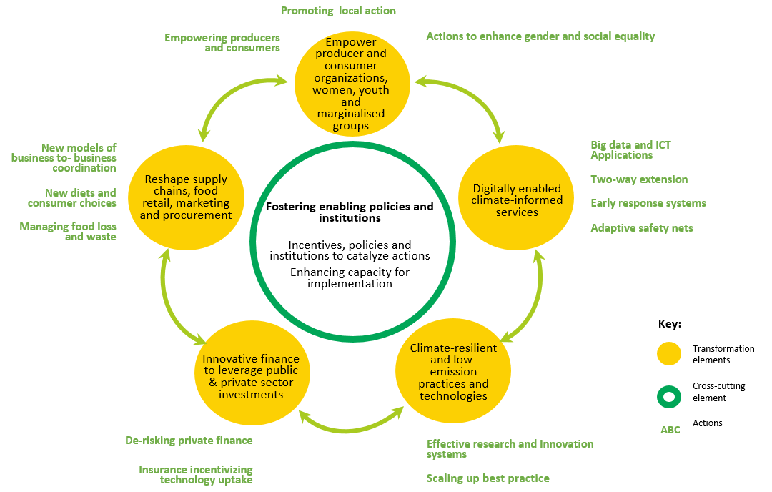
For solutions and practical advise on rural agriculture in general see this paper
https://ccafs.cgiar.org/publications/rural-livelihoods-food-security-and-rural-transformation-under-climate-change#.XqBRj8gzZPY
Notes:
I am not going to talk about this slide but putting it there for any of you who are looking at solutions re rural livelihoods more generally.

Slide 41

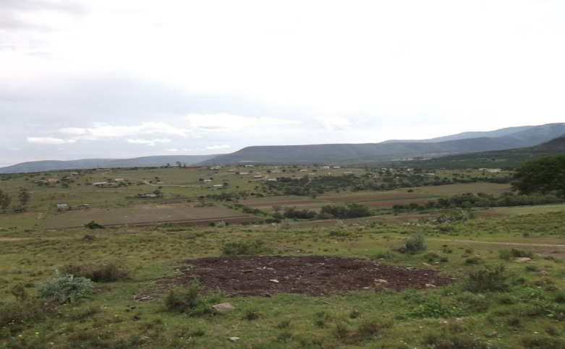
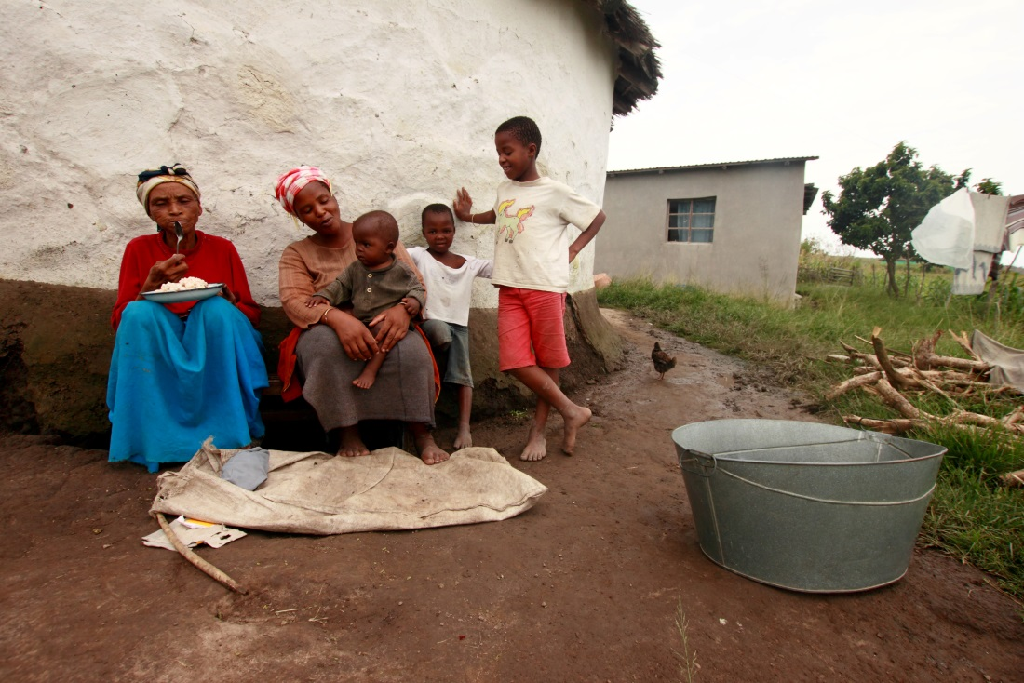
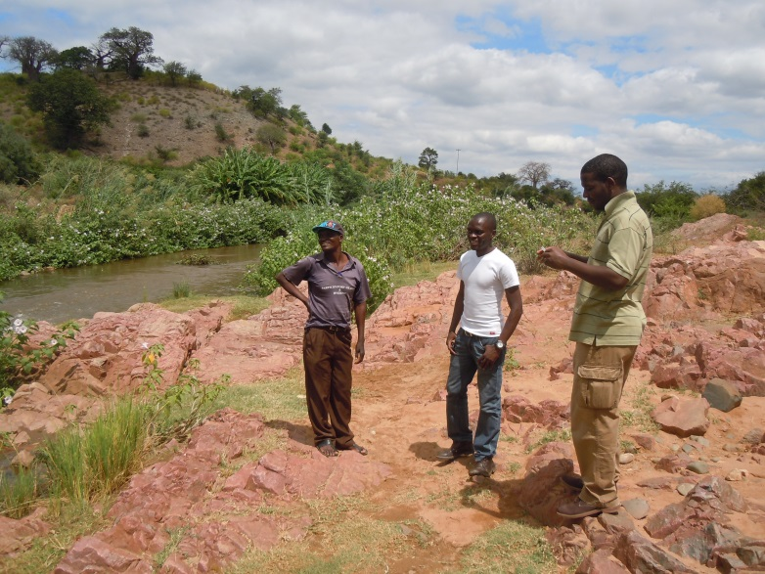
Thank you

