Slide 1



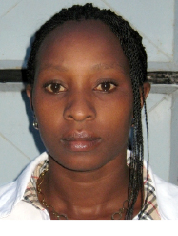
Jane Mutune
Nairobi
REGIONAL
NETWORK MEETING
Lecturer, Nairobi University and researcher in AgriFoSe
#Collab4FS
15 November 2023, hybrid format in Nairobi, Kenya

Slide 2
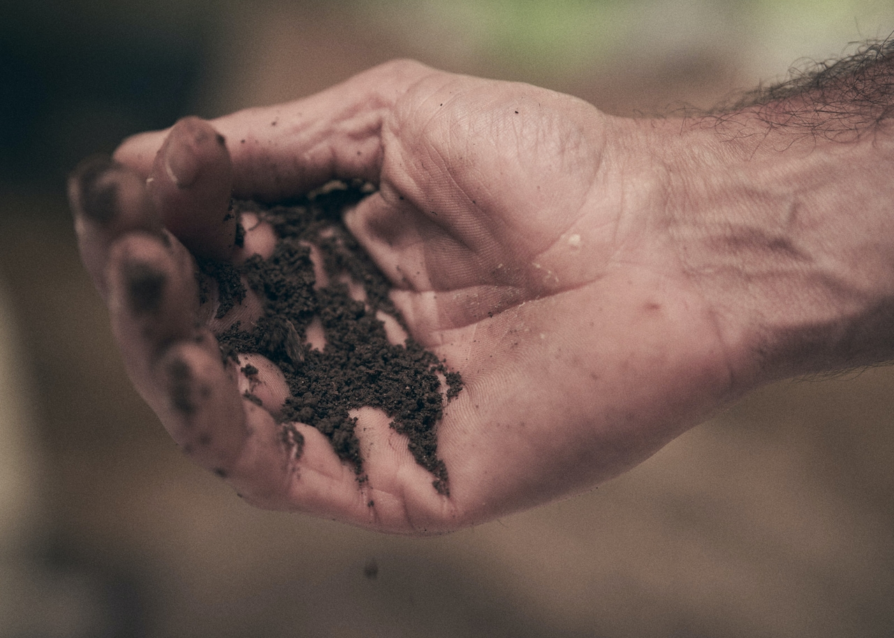
Researcher’s perspectives on the role of science in food system transformation
Jane Mutune (PhD)
Wangari Maathai Institute for Peace and Environmental Studies
University of Nairobi

Slide 3
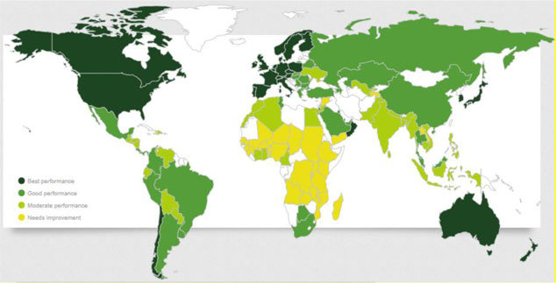
Threats to Food Security
The global food crisis affecting millions people
WFP estimates 77 countries, 345 million people faced high levels of acute food insecurity
10% more than in 2022.
Africa, with scores ranging from 34 to 37 for their low availability and affordability of food supplies and deficient quality and safety standards.
Landscape Degradation;
Climate change devastatingly impacts livelihoods;
Covid-19 pandemic

Slide 4
How is the research and science helping?
Science and research are fundamental drivers of innovation
accelerating transformation to healthier, sustainable, equitable, and resilient food systems (Fears and Canales 2021).
Value addition technologies- Reduce food losses
Good governance- inclusion and equity of SHF in process of food system transformation
Linkages and networks
Evidence-Based Policies and Practices
Revisit true value of food- health and environmental costs

Slide 5
Bioscience innovations- hold great promise to meet several food systems challenges.
Digital innovations and engineering- make food systems more sustainable, reduce food waste and loss, and improve hygiene.
Socio-science- actors and sustainability of FS

Slide 6
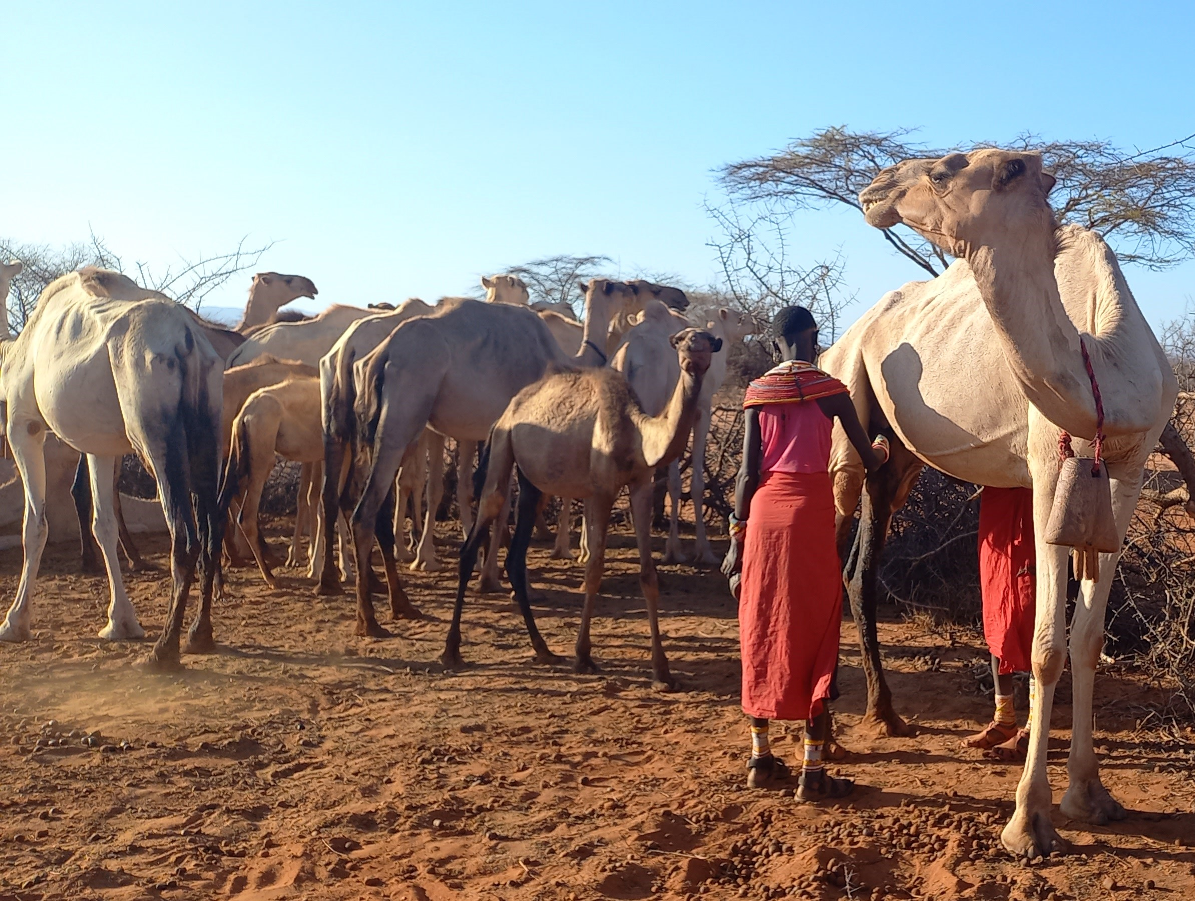
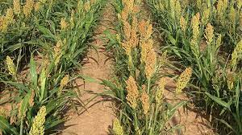
Innovations that reshape food systems beyond business-as-usual
Crop-sensing technologies help with fertilizer efficiency by assessing plant nitrogen needs.
Such technology has, in Mexico, increased profit by $37/hectare and avoided over 9,500 tons of greenhouse gas emissions for wheat farmers.
Drought tolerant crops and livestock for sustainable FS- underpinned in science
Action research- locally adaptable cultivars, breeds
Climate resilient varieties- cassava varieties in Nigeria, early maturing, pest- and drought-resistant, and have increased yields by over 60 percent

Slide 7
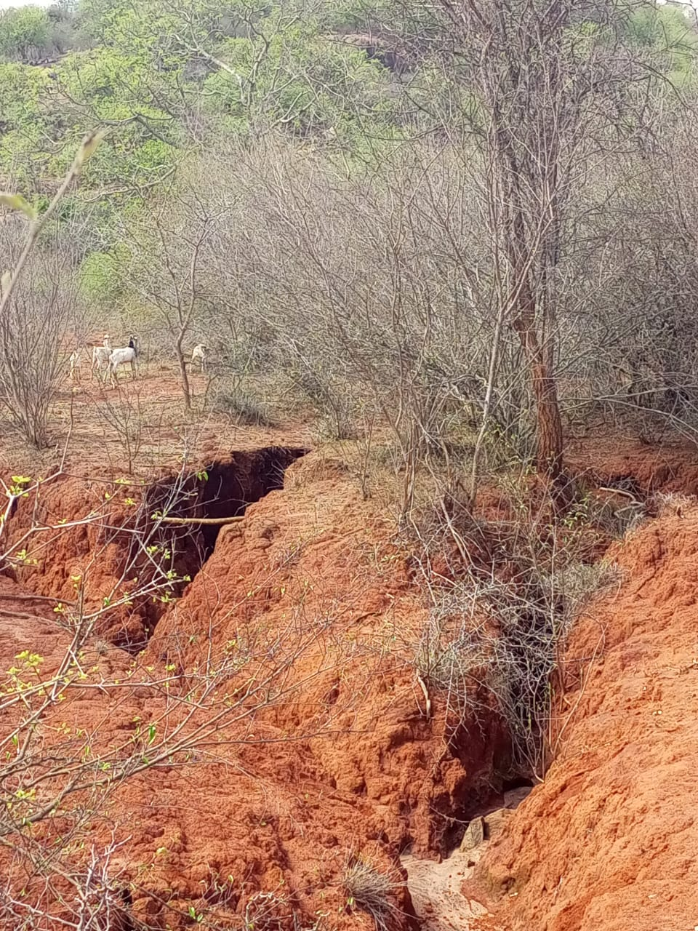
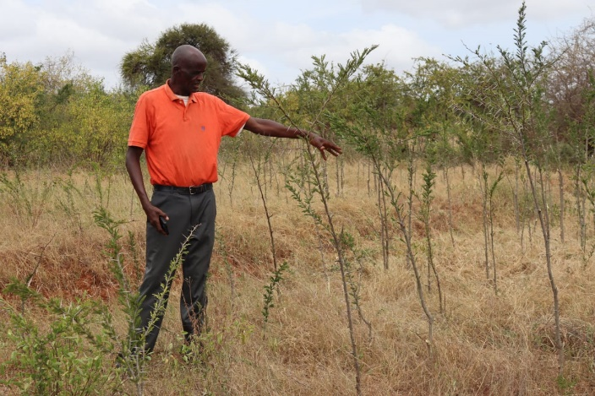
Food systems must be based on sustainable landscapes
NbS- FMNR, agroforestry

Slide 8
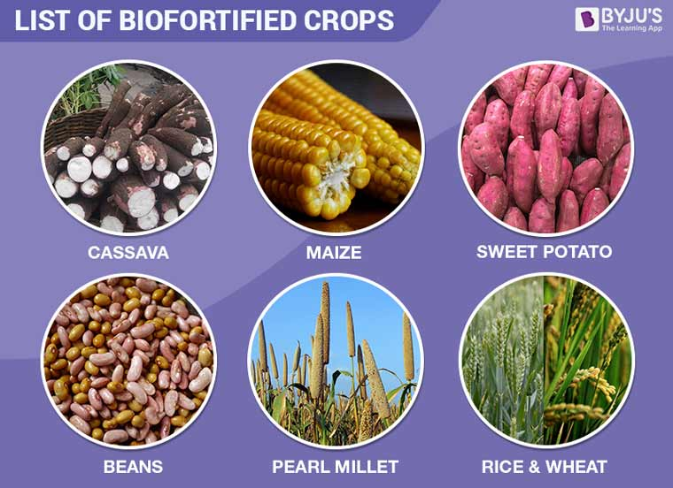

Technologies that are nutrition-driven or nutrition-sensitive, such as biofortification, provide vitamin- and mineral-rich crops in over 30 countries
Technologies reduce post harvest losses

Slide 9
Strengthening Capacities and the science-policy Interface
Continued and expanded investments in institutional and human capacities
Investments should go into improving data, methods, models and tools for all food system components and actors and for
building or enhancing shared research infrastructures.
Nations must revisit their low research spending on agriculture and food systems.
strengthening local research capacities and expanding research collaboration among public and private sector research.
Intellectual property rights issues- addressed when they hinder innovations that serve food and nutrition security and food safety.

Slide 10

Research scientists primary producers of policy-related evidence.
Boundaries of evidence production and consumption can blur.
This is, in part, driven by the vast amount of research available to the typical policymaker today.
Scientists as “sifters, synthesizers, and analyzers” to help policymakers who may not have time to consider all research and information available.

Slide 11
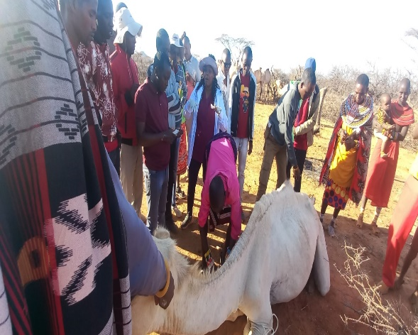
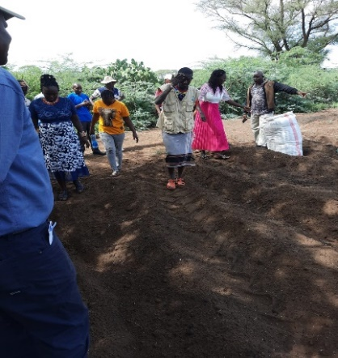
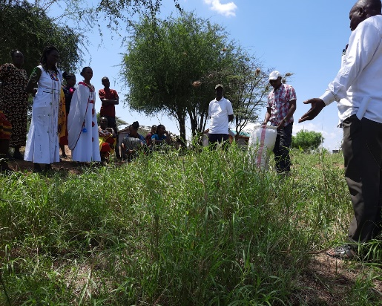
Science success
Many of innovations will only materialize for the poor if innovations are adapted to local conditions and are accessible and affordable to all producers, especially small-scale producers.
.
Livelihood diversification
Landscape restoration

Slide 12
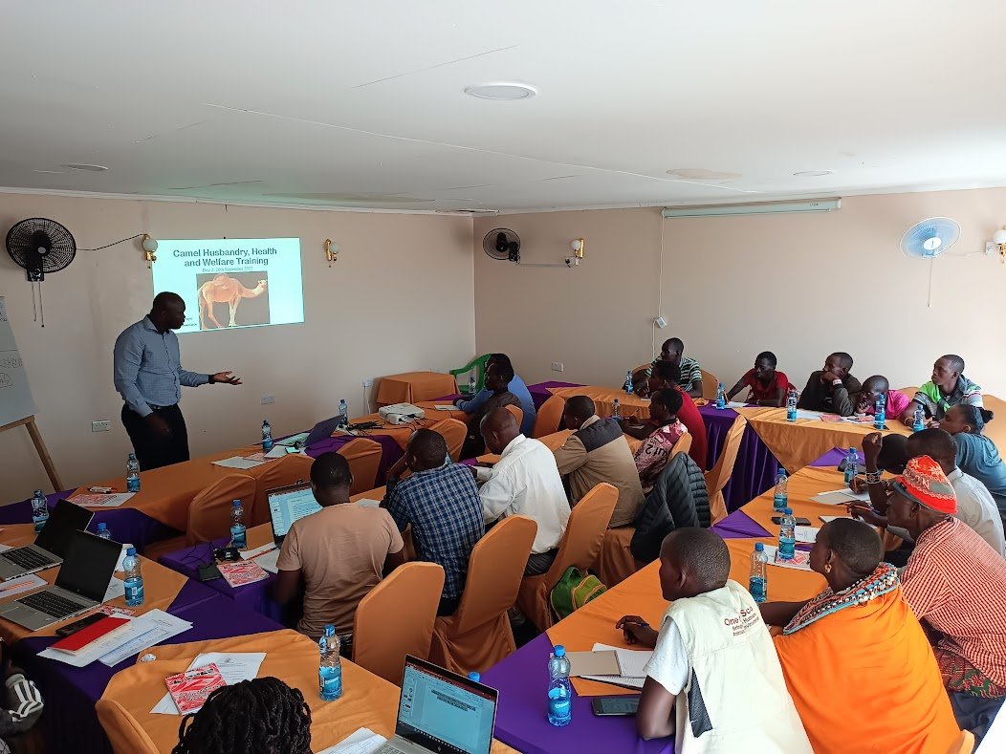
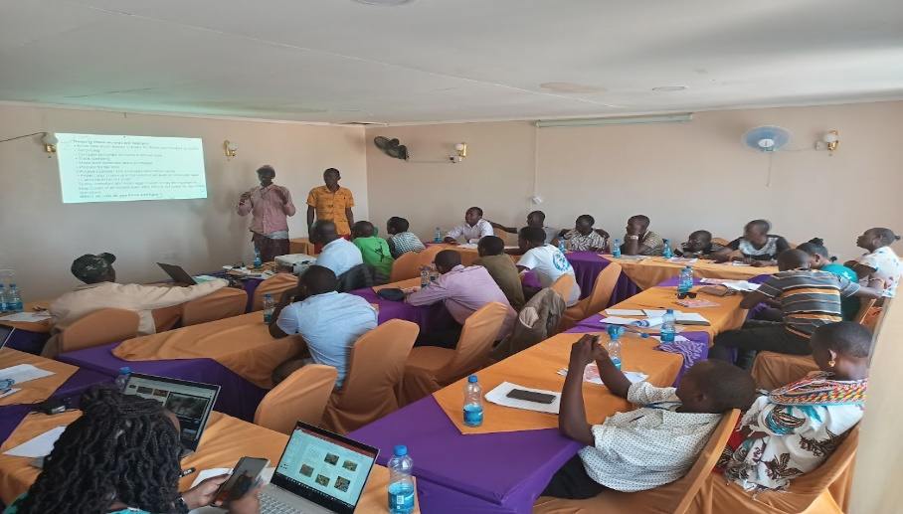
science success
open information sharing is needed to ensure that users are aware innovations costs and benefits of new technologies, based on available scientific evidence

Slide 13
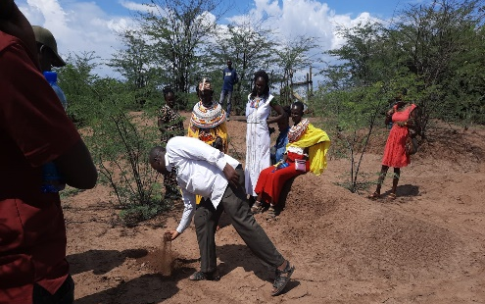
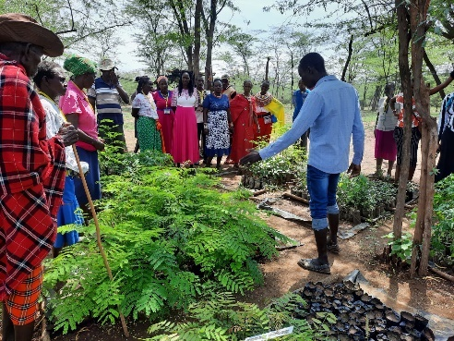
Science into practice
Co-learning- knowledge and skills
Co-production of knowledge materials
Collaboration- multi-stakeholders
Communication- translate science into practice and policy
Co-design- with beneficiaries and local government/policy makers

Slide 14
Science in Sustainable food systems need
Systems innovations than single-issue innovations,
Enhanced collaboration among different science disciplines
Empirical evidence ought to be:
Co-design, co-learn, co-produced; collaborate and communicate
Increased investment in research and development
Strong institutions including policy and practice
Enhanced MEL and accountability is important to track our progress,
Leverage research for policy-based evidence on policy-makers’ needs

Slide 15


